Slide 1
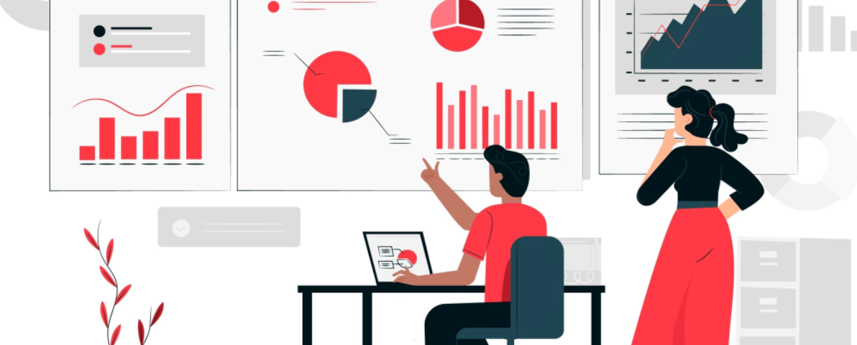
Data Pre-Processing & Visualization for Machine Learning
Preparing Clean, Meaningful Data for ML Models
Presenter: M Fahad Bashir

Slide 2

Welcome to the Workshop!
Purpose of Today's Session
Understand why data preparation is the bedrock of successful machine learning.
The Importance of Clean Data
Learn why pre-processing and visualization are critical steps before building any ML model.
Fitting into the ML Pipeline
Discover how today's topics seamlessly integrate into the broader machine learning workflow.

Slide 3
Workshop Agenda: Your Path to Data Mastery
01
02
03
Understanding Data
Why Pre-Processing?
Common Data Problems
What is data in the context of machine learning?
Uncover the critical need for data preparation.
Identify the pitfalls of real-world datasets.
04
05
06
Pre-Processing Techniques
Data Visualization
Live Demonstration
Explore practical methods to clean and transform data.
Learn to communicate insights through compelling visuals.
See these concepts in action with a hands-on example.
07
Q&A Session
Your chance to ask questions and deepen your understanding.

Slide 4



Why Data Comes First: The Foundation of ML
The success of any machine learning model hinges entirely on the quality of the data it's trained on.
Real-world data is inherently messy and imperfect.
"Garbage In → Garbage Out"
This timeless adage perfectly captures the essence of data quality in ML.
80% of ML project time is dedicated to data preparation.
This highlights the immense importance of pre-processing.

Slide 5
Understanding Data: The Building Blocks
At its core, data is a collection of observations, organized to reveal patterns and insights.
Example: Student Data
Rows → Samples
Student ID
Marks
Age
Gender
Each row represents an individual observation or instance.
001
85
20
Male
Columns → Features
002
92
21
Female
Each column describes an attribute or characteristic of the samples.
003
78
19
Male
Target / Label
This table illustrates how samples (students) are described by various features (marks, age, gender).
The specific outcome or variable we aim to predict.

Slide 6
Types of Data
Data comes in many forms, each requiring specific handling for machine learning algorithms.
Structured Data
Unstructured Data
Numerical Data
Categorical Data
Highly organized and formatted, like tables in CSV files or Excel spreadsheets, making it easy to store and analyze.
Lacks a predefined format, such as free-form text, images, audio recordings, and video files, requiring advanced processing.
Quantitative measurements, including integers (discrete) and floating-point numbers (continuous), representing quantities or values.
Qualitative information that can be divided into groups or categories, such as gender, country, or product type.

Slide 7

Common Data Problems: The Obstacles to Insight
Real-world datasets are rarely perfect. Understanding common issues is the first step towards effective data preparation.
Missing Values
Duplicate Records
Absence of data points, often represented as 'NaN' or empty cells.
Identical entries that can skew model training and results.
Categorical Values
Different Scales
Text-based or ordinal data that needs numerical encoding.
Features with vastly different ranges can bias certain algorithms.
Outliers
Noise in Data
Data points significantly different from others, potentially causing misinterpretations.
Random errors or irrelevant information that obscures true patterns.
👉 These challenges highlight the crucial role of data pre-processing in preparing your data for robust ML models.

Slide 8
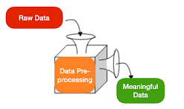
What is Data Pre-Processing?
Data preprocessing is the process of cleaning, transforming, and organizing raw data to make it suitable for machine learning models.
It's the essential groundwork that ensures your machine learning algorithms receive the best possible input, leading to more accurate and reliable predictions.
Cleaning
Handling missing values, correcting errors, and removing duplicates.
Transforming
Converting data into a format that algorithms can understand, like encoding categorical variables.
Organizing
Structuring data, scaling features, and dealing with outliers for optimal model performance.

Slide 9
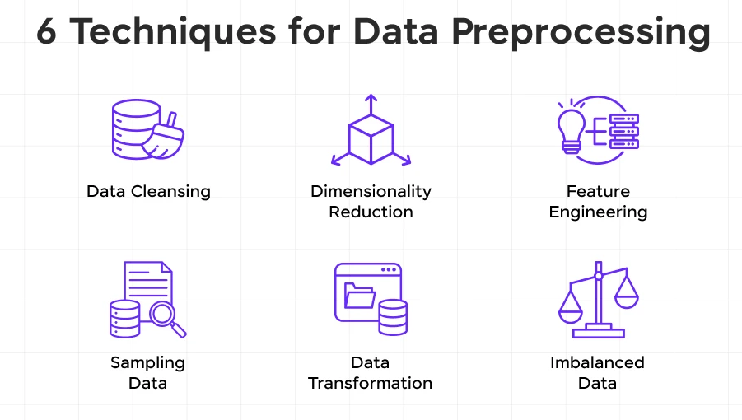
The Data Pre-Processing Pipeline: A Systematic Approach
The pre-processing pipeline is a series of methodical steps that refine raw data into a pristine, model-ready format.
Raw Data
The initial, untouched dataset, often messy and incomplete.
Cleaning
Addressing missing values, duplicates, and inconsistencies.
Transformation
Reshaping data, encoding categories, and standardizing features.
Feature Engineering
Creating new, more informative features from existing ones.
Ready for ML
The polished, optimized dataset, primed for model training.

Slide 10

Handling Some Common Issues

Slide 11
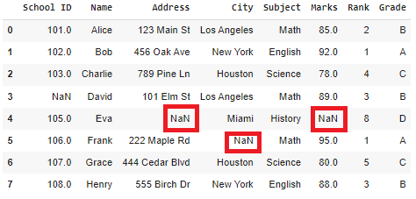
1. Missing Data
What are Missing Values?
Missing values occur when data is not available for a feature
Represented as: NaN, NULL, empty cells
Why Are Missing Values a Problem?
ML models cannot work with missing data
Can bias model predictions
Reduce data quality
Common Techniques to Handle Missing Values
Remove rows (if missing data is very small)
Remove columns (if feature is mostly empty)
Mean / Median / Mode Imputation
Key Tip: Choose a method based on data type and problem — not randomly.

Slide 12
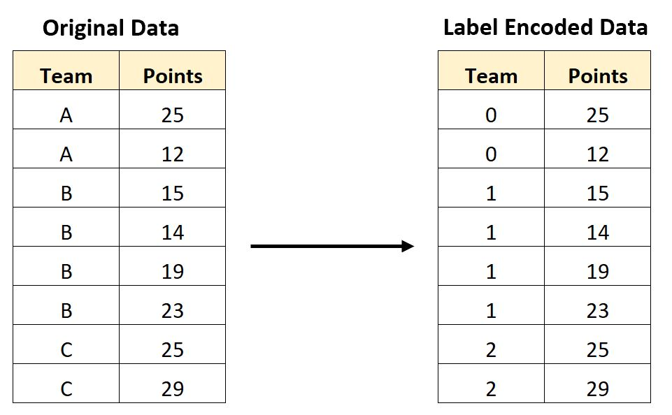
2. Handling Categorical Data
What is Categorical Data?
Data with labels or categories
Examples: Gender: Male, Female
City: Lahore, Karachi, Islamabad
Why Encoding is Required?
ML models understand numbers, not text
Encoding Techniques
Label Encoding: Converts categories to numbers Example: Male → 0, Female → 1
One-Hot Encoding: Creates new binary columns Best for non-ordinal categories
When to Use What?
Label Encoding → ordinal data
One-Hot Encoding → nominal data

Slide 13
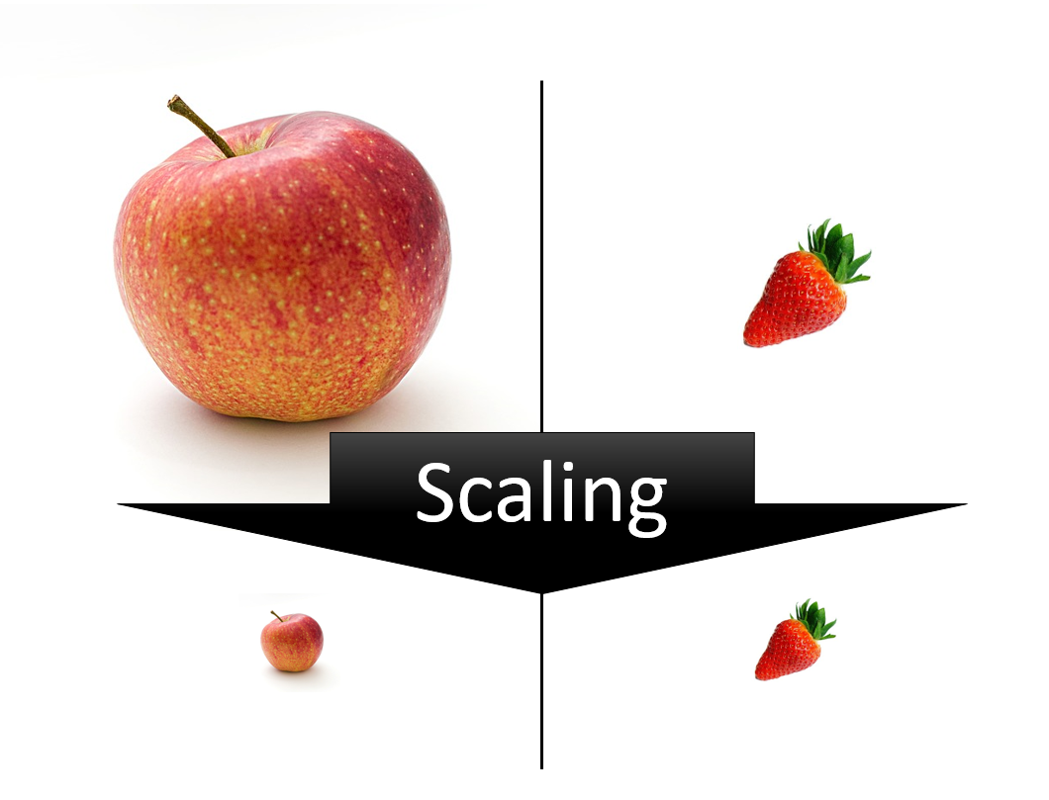
3. Feature Scaling
What is Feature Scaling?
Bringing features to the same range
Why is Scaling Important?
Features have different units (age vs salary)
Distance-based models get biased
Faster and better model convergence
Common Scaling Methods
Normalization Range: 0 to 1
Standardization Mean = 0, Std = 1
Important Note Scaling is critical for models like KNN, SVM, Gradient Descent

Slide 14
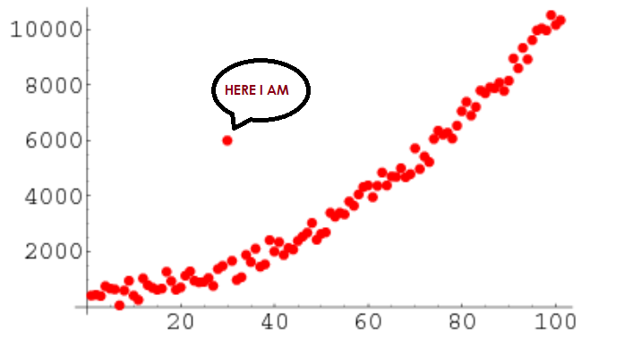
4. Handling Outliers
What are Outliers?
Extreme values that differ from most data
Example: Salary = 1,000,000 when average is 50,000
Why Outliers Are Dangerous?
Skew model learning Affect mean and variance
Reduce prediction accuracy
Detecting Outliers
Box plots
Interquartile Range (IQR)
Visualization methods
Should We Always Remove Outliers?❌ No✔ Depends on domain knowledge

Slide 15
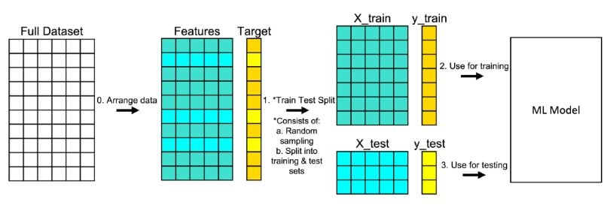
5. Train Test Split
What is Train-Test Split?
Dividing dataset into:
Training set → model learns
Testing set → model evaluation
Why is It Important?
Prevents overfitting
Tests model on unseen data
Common Splits
70% Train – 30% Test
80% Train – 20% Test
Key Rule Never test on training data — it gives false confidence.

Slide 16
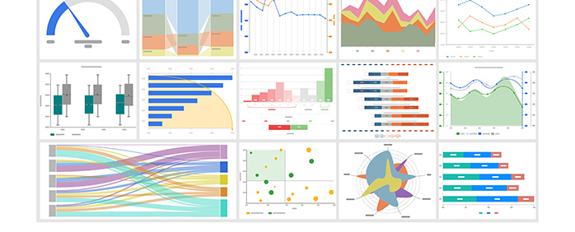
Data Visualization

Slide 17
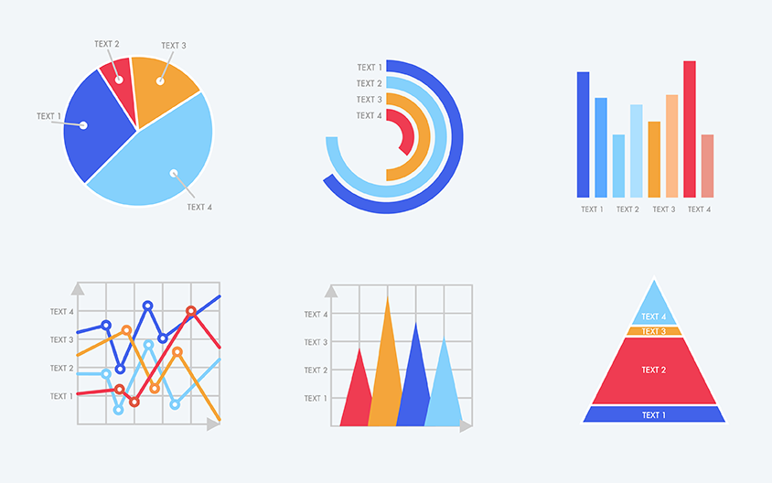
What is Data Visualization
Data visualization is the graphical representation of data
Converts numbers into visual insights
Makes patterns easier to understand
Why Humans Need Visualization
Humans understand visuals faster than tables
Patterns, trends, and anomalies become obvious
Helps in better decision-making

Slide 18
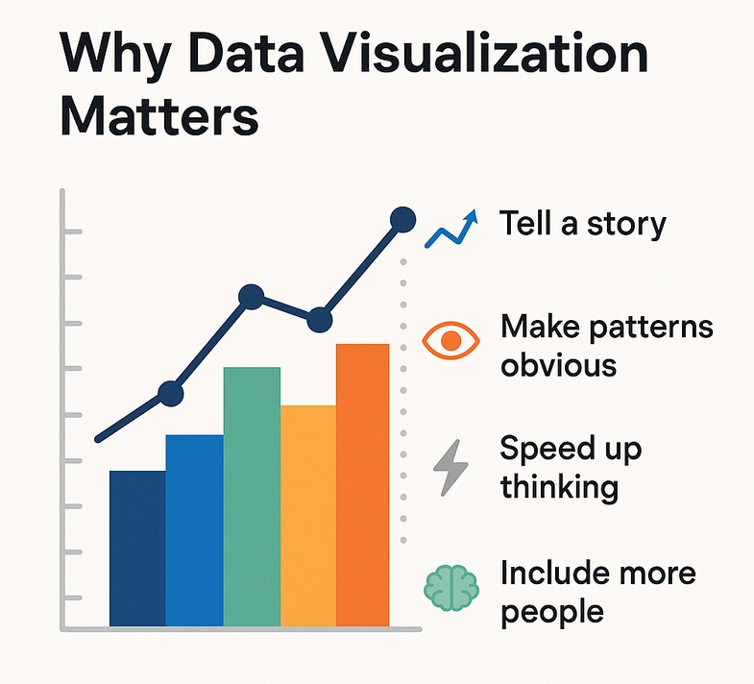
Why Data Visualization Matters in ML
Helps Understand the Data
Distribution of values
Frequency of categories
Detect Data Issues
Outliers
Missing values
Skewed distributions
Helps in Model Selection
Linear vs non-linear relationship
Feature importance
Correlation between features
Visualization is not for presentation — it is for understanding data before modeling.

Slide 19
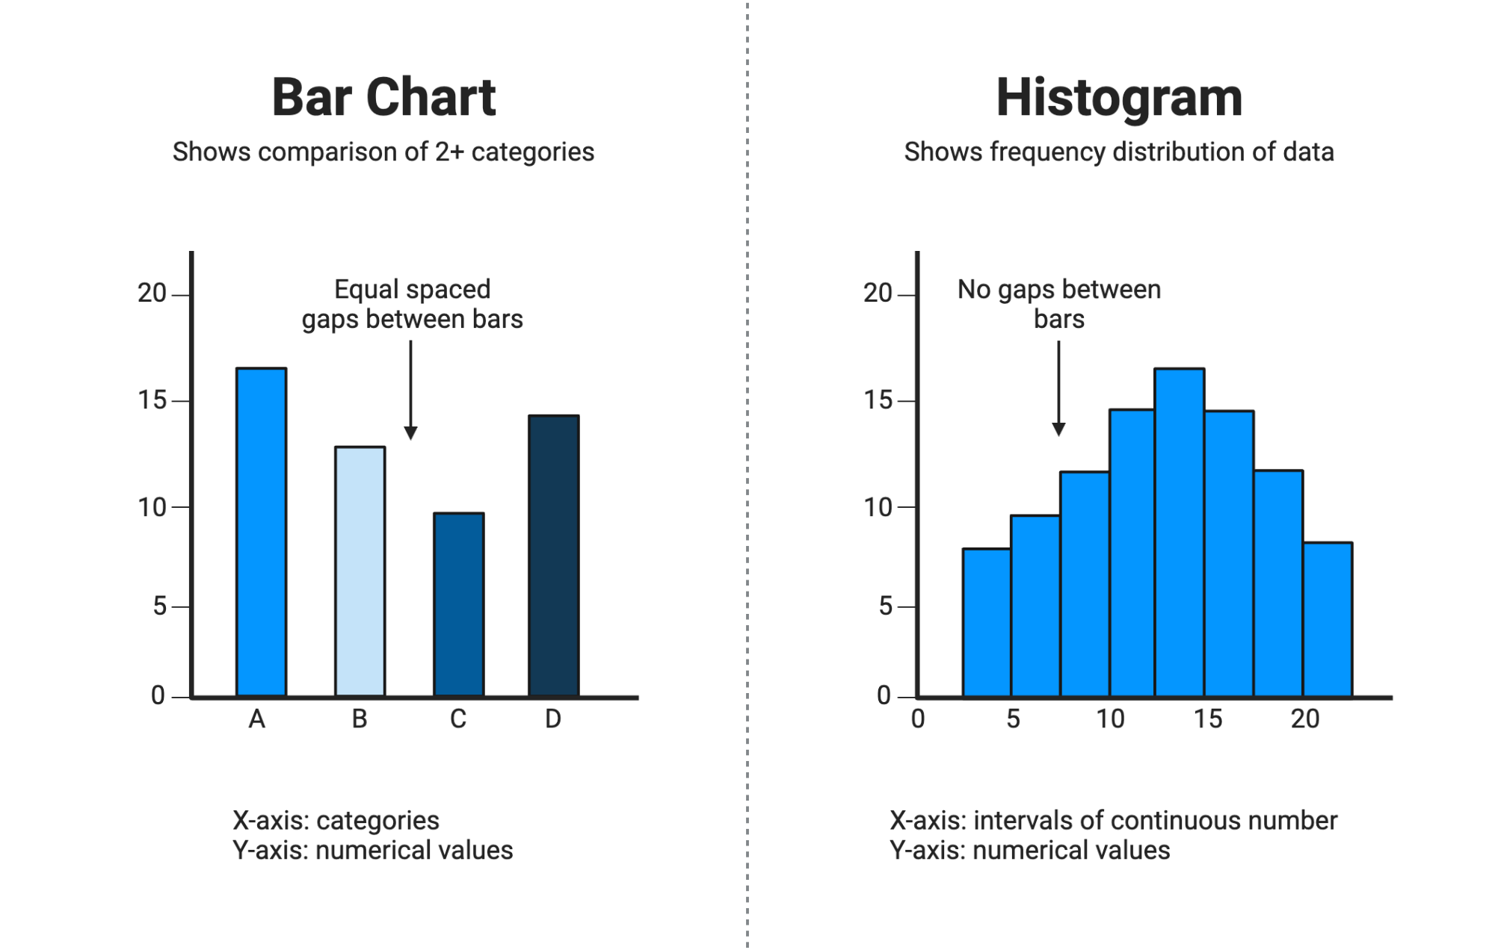
Common Visualization Techniques
Histogram
Shows distribution of numerical data
Helps identify skewness and outliers
Example: Age distribution
Bar Chart
Used for categorical data
Shows frequency or count
Example: Gender distribution

Slide 20
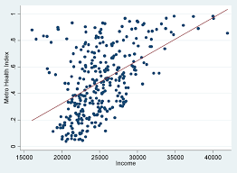
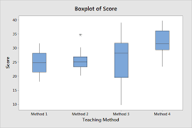
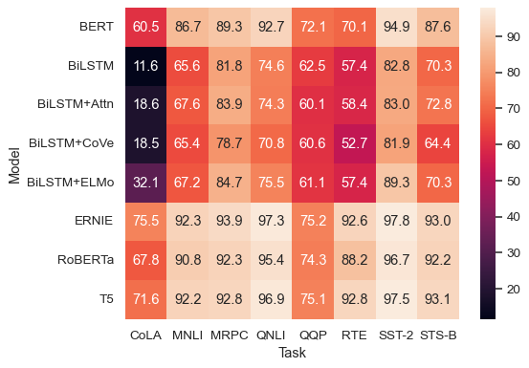
Common Visualization Techniques
Scatter Plot
Shows relationship between two variables
Helps detect trends and clusters
Example: Area vs Price
Box Plot
Detects outliers
Shows median and spread
Best for outlier analysis
Heatmap
Shows correlation between features
Helps in feature selection
Values between -1 to +1

Slide 21
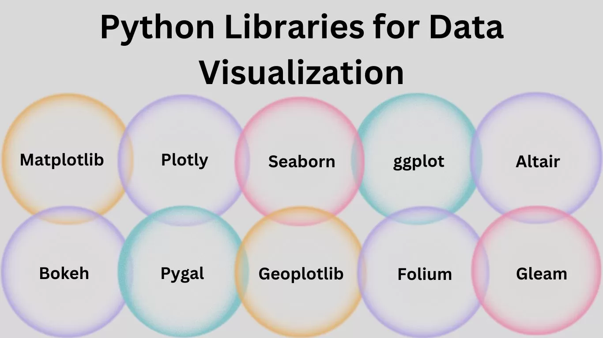
Visualization Tools & Workflow
Matplotlib – basic plotting
Seaborn – statistical visualizations
Pandas – quick plots
Google Colab – easy environment
Visualization is like X-ray of your data — it shows hidden problems before the model sees them.

Slide 22
Key Takeaways
Clean data improves model performance
Visualization helps understand data
Pre-processing is mandatory before ML
Good data > complex models

Slide 23

Before training models, train your data

